Slide 1

Bluestock Mutual Fund Analytics Platform
An End-to-End Data Engineering & Financial Intelligence Project

Slide 2
Problem Statement & Objectives
Problem Statement
Large volume of mutual fund data is generated daily.
Difficult to manually analyze performance and investor trends.
Need a centralized analytics platform for insights.
Objectives
Analyze NAV & fund performance
Track AUM growth
Study SIP inflows
Analyze investor behavior
Evaluate risk metrics
Build dashboards

Slide 3
Data Sources
Fund Master - Contains metadata about mutual fund schemes such as fund house, category, benchmark, and expense ratio
NAV History - Stores historical Net Asset Value (NAV) data used to track fund performance over time.
AUM Data - Contains Assets Under Management (AUM) information for different fund houses.
SIP Inflows - Tracks monthly Systematic Investment Plan (SIP) investments and investor participation.
Category Inflows - Records net investment inflows and outflows across mutual fund categories.
Folio Count - Provides the number of investor folios, indicating growth in investor participation.
Scheme Performance - Contains return and risk metrics such as Alpha, Beta, Sharpe Ratio, and CAGR.
Investor Transactions - Stores investor-level transaction details for demographic and behavioral analysis.
Portfolio Holdings - Contains stock holdings and sector allocations of mutual fund portfolios.
Benchmark Indices - Provides market index data used for fund performance comparison and risk analysis.

Slide 4
System Architecture
ETL Activities
Data Cleaning
Missing Value Handling
Dataset Integration
Feature Engineering
KPI Generation
Data Sources
Transform
Extract
Analytics
Load
Dashboard

Slide 5
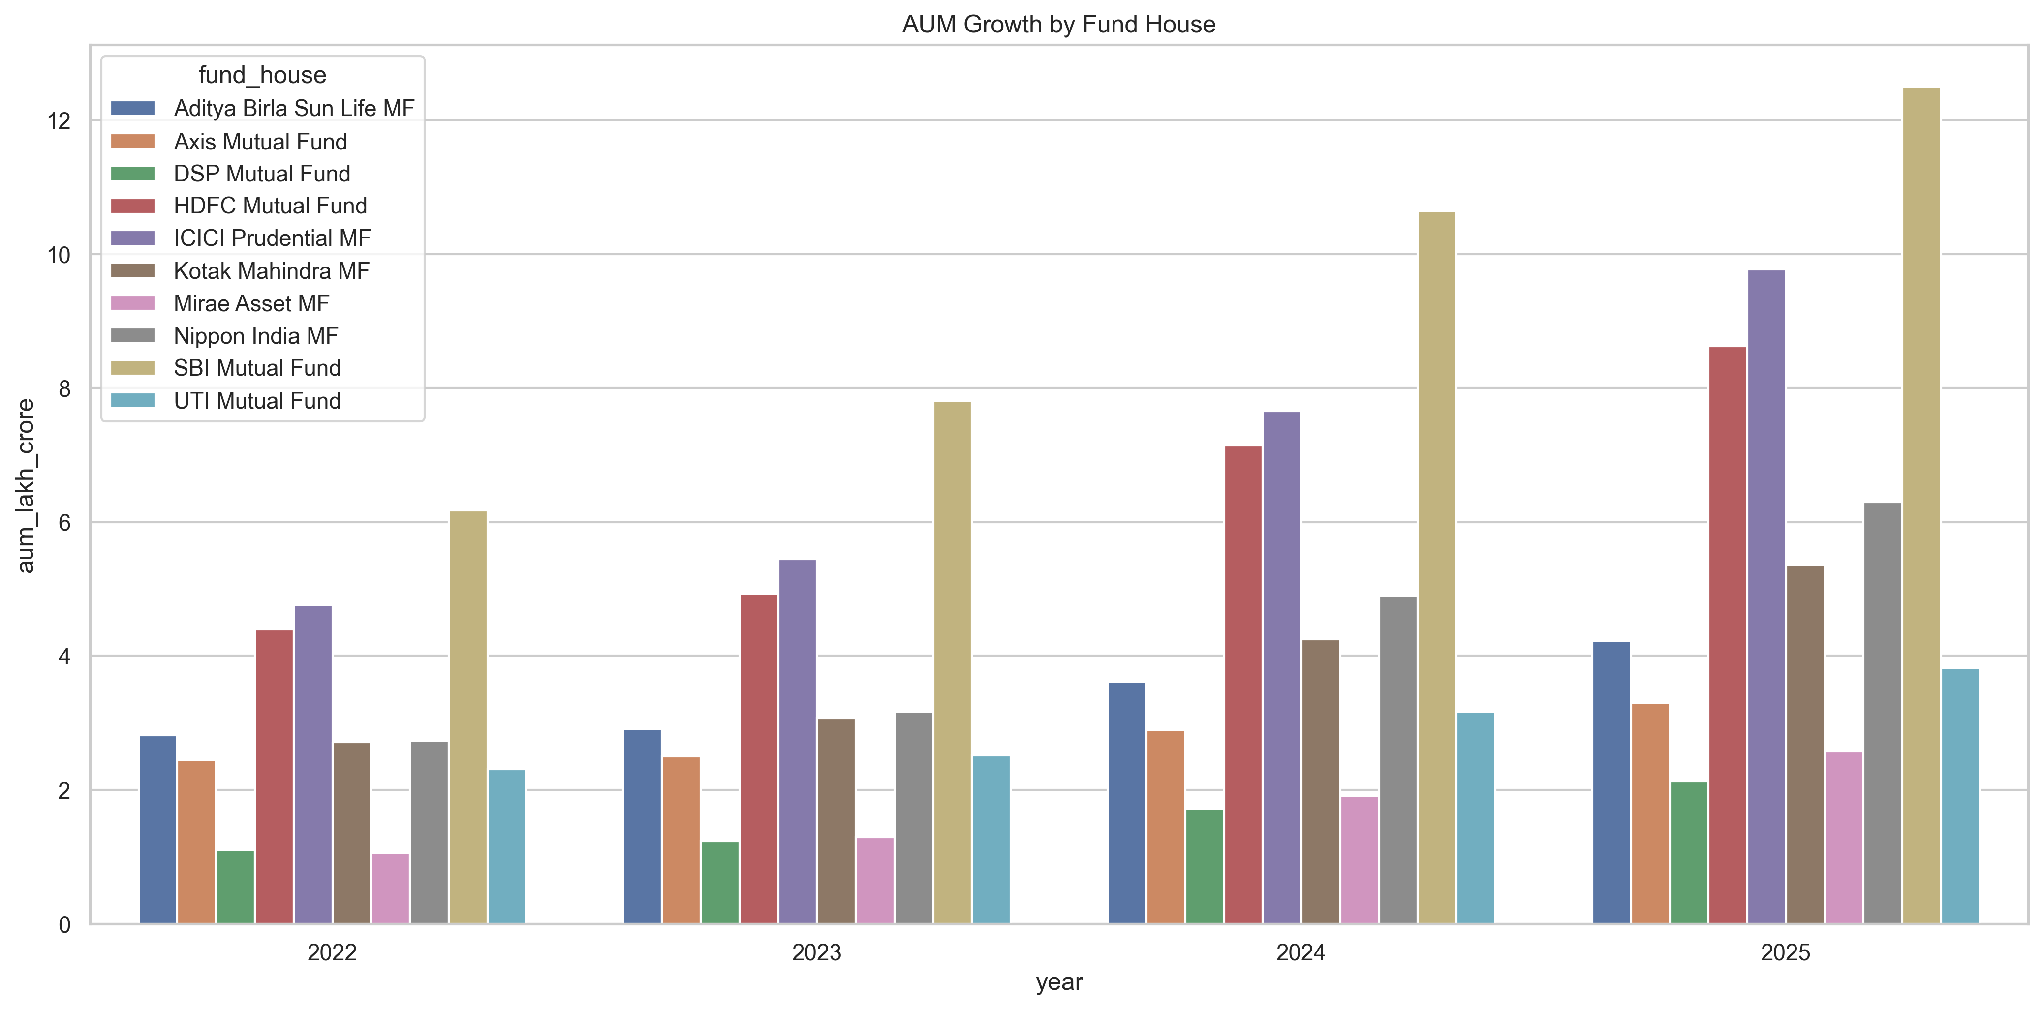
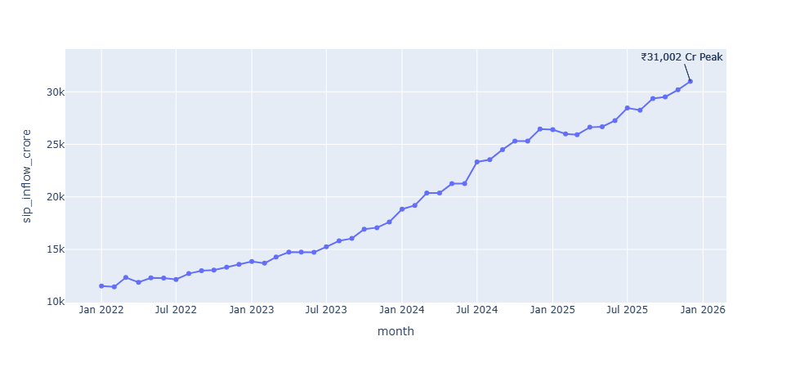
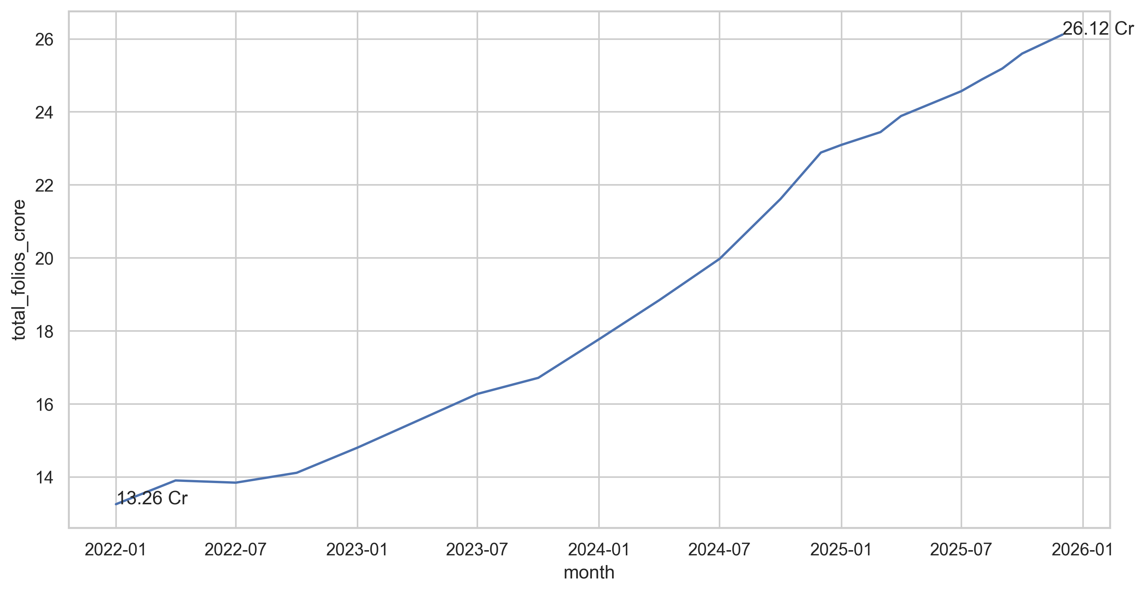
EDA Highlights – Industry Trends
Key Insights
AUM Growth
Consistent growth across major fund houses
SBI MF leads industry AUM
SIP Growth
SIP inflows crossed ₹31,000 Cr
Folio Growth
Folios increased from 13.26 Cr to 26.12 Cr

Slide 6

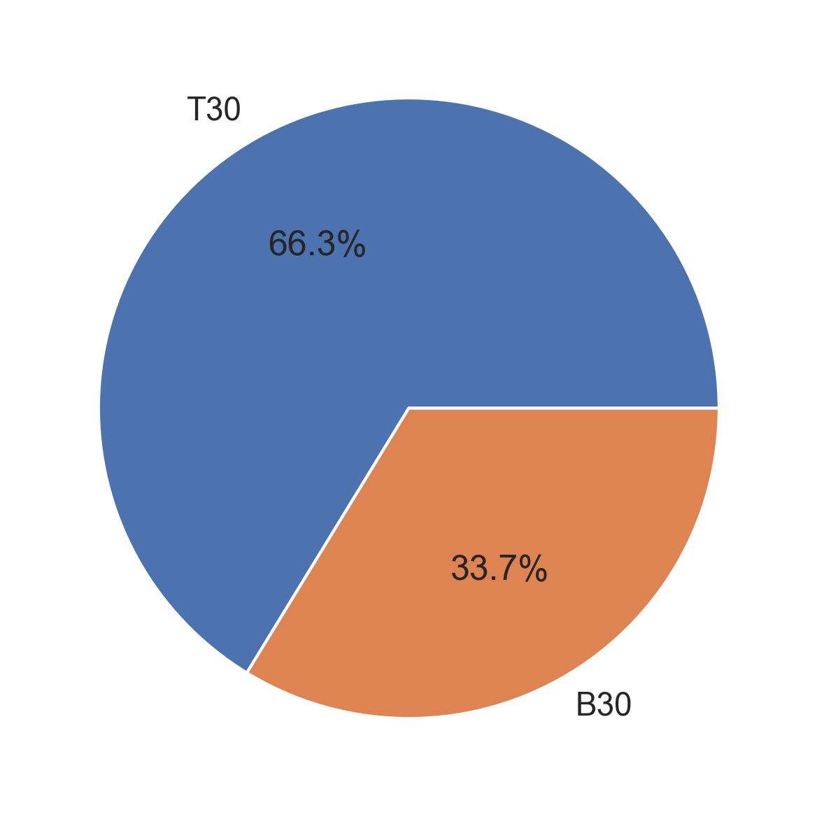
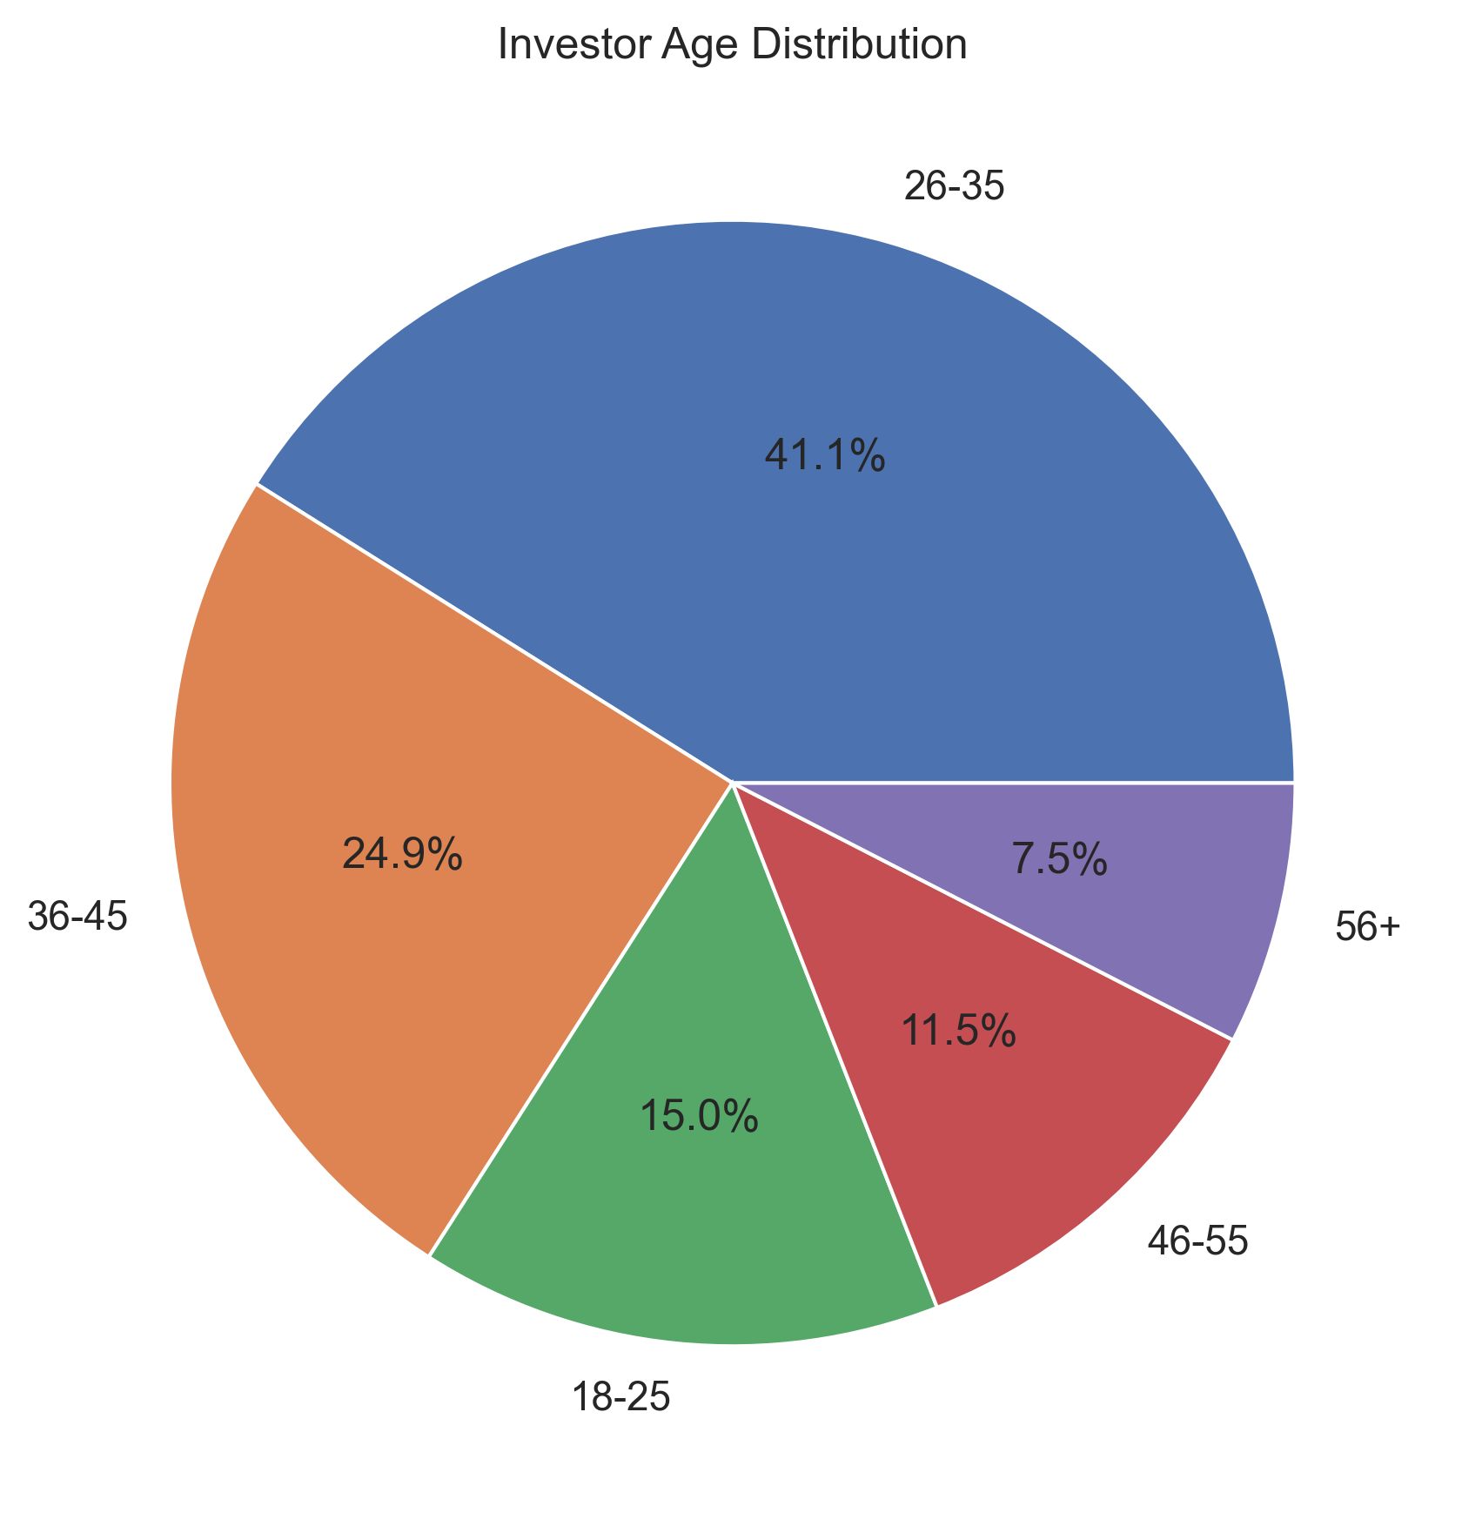
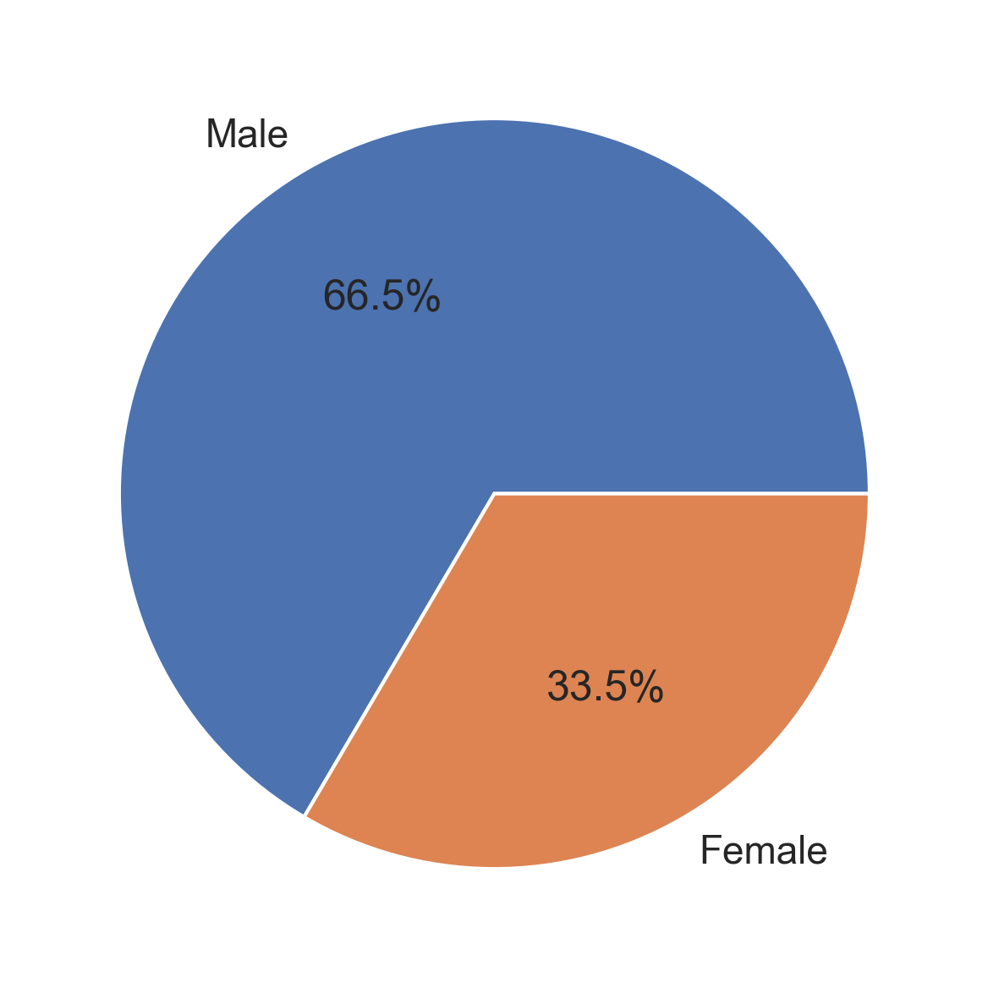
EDA Highlights – Investor Analytics
Investor Demographics
Age Distribution:
26–35 years = largest investor group
Gender Split:
Male: 66%
Female: 34%
Geographic Distribution:
T30 Cities: 66%
B30 Cities: 34%

Slide 7
Performance Metrics – Return Analysis
Metrics Used
Daily Returns: Measures the day-to-day percentage change in a fund's NAV.
CAGR: Shows the average annual growth rate of an investment over a period.
Rolling Returns: Evaluates the consistency of fund performance across different time windows.
Alpha: Measures how much a fund outperforms or underperforms its benchmark

Slide 8
Performance Metrics – Risk Analysis
Metrics Used
Beta: Measures how sensitive a fund is to overall market movements.
Sharpe Ratio: Measures the return generated for each unit of total risk taken.
Sortino Ratio: Measures the return generated for each unit of downside risk.
Maximum Drawdown: Measures the largest decline in fund value from its peak.
Correlation Matrix: Shows how closely different funds move relative to each other.

Slide 9
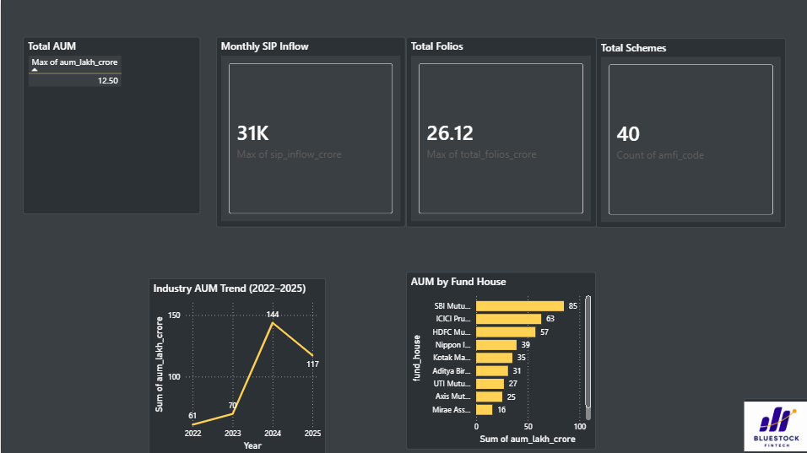
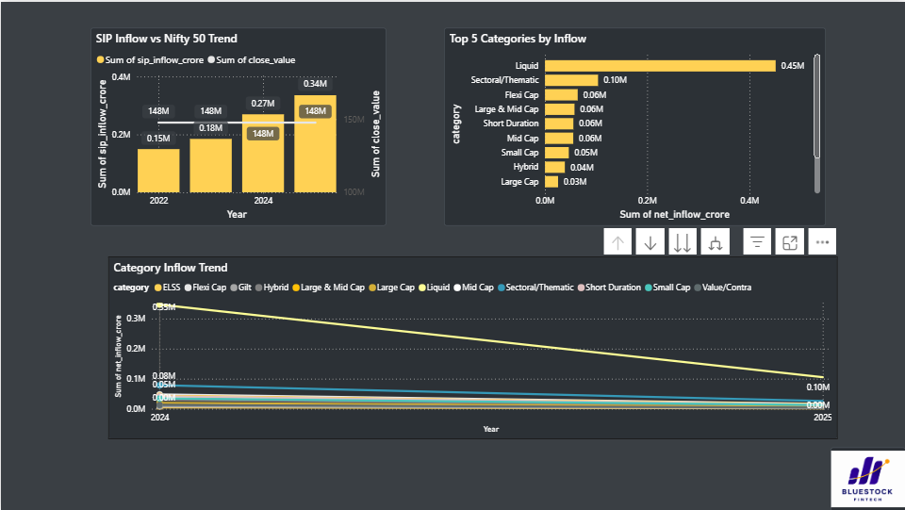
Dashboard Showcase – Industry Overview
Dashboard Highlights
Tracks Total AUM, SIP Inflows, Folio Growth, and Category-wise Inflows.
Provides a high-level view of mutual fund industry growth.
Enables comparison of fund houses and investment categories.
Monitors investor participation trends over time.
Key Insights
SIP inflows exceeded ₹31,000 Cr, indicating strong retail participation.
SBI Mutual Fund emerged as the largest fund house by AUM.
Folio counts nearly doubled, reflecting rapid industry expansion.
Liquid Funds attracted the highest net inflows among all categories.

Slide 10
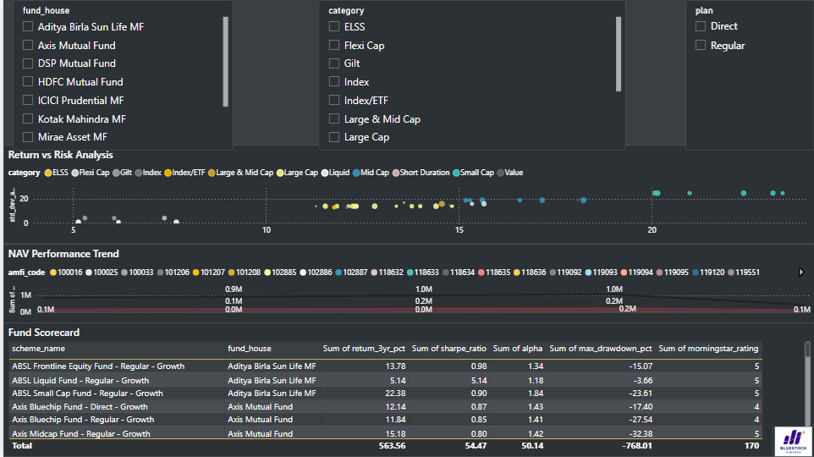
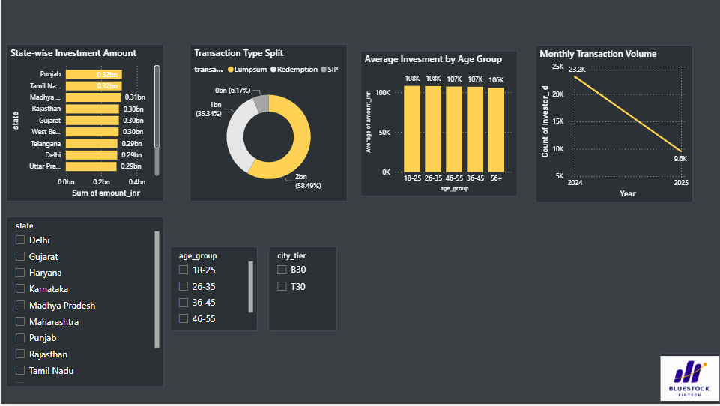
Dashboard Showcase – Performance & Investor Analytics
Dashboard Highlights
Evaluates fund performance using CAGR, Sharpe Ratio, Alpha, and custom scorecards.
Analyzes investor demographics and transaction behavior.
Visualizes geographic participation and investment patterns.
Supports identification of high-performing and risk-adjusted funds.
Key Insights
Investors aged 26–35 represent the largest investor segment.
T30 cities contribute the majority of investment volume.
Lumpsum transactions account for the highest investment amount.
Several funds demonstrated strong risk-adjusted performance through positive Sharpe Ratios and Alpha values.

Slide 11
Key Findings
Major Findings
SIP inflows continue to rise
AUM growth remains strong
Investor participation nearly doubled
Young investors drive market growth
T30 cities dominate investments
Positive Alpha observed in multiple schemes
Diversification opportunities exist

Slide 12
Thank You
Conclusion
Successfully built an end-to-end Mutual Fund Analytics Platform using ETL, analytics, and dashboarding techniques.
Technologies Used
Python
Pandas
NumPy
Matplotlib
Power BI
Thank You

